Slide 1

Crafting Compelling Narratives: The Data Storytelling Challenge E- commerce supply chain
- Mayank Srivastava

Slide 2
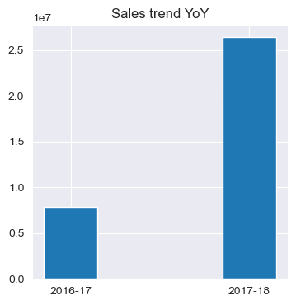
About the dataset
Period 04-Sep-2016 to 03-Sep-2018
89,316 transactions
Customer belonging to 27 states & 3735 cities
70 product categories
2929 sellers
1st year sales 7.88 million USD
2nd year sales 26.41 million USD
Increase in revenue 2.35 times

Slide 3
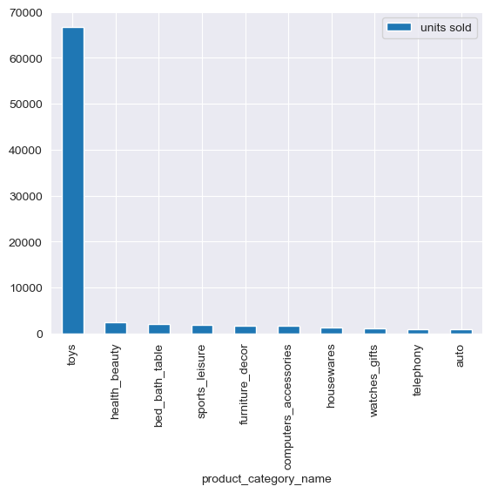
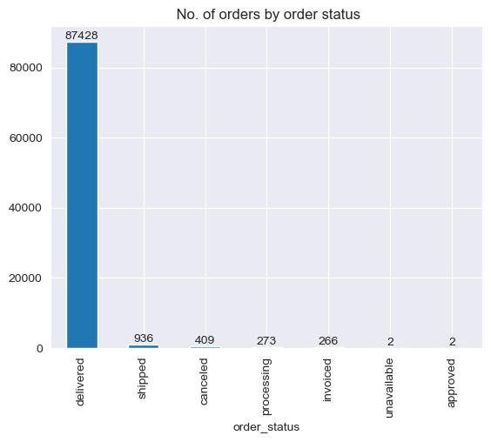
Order status
Top product categories

Slide 4
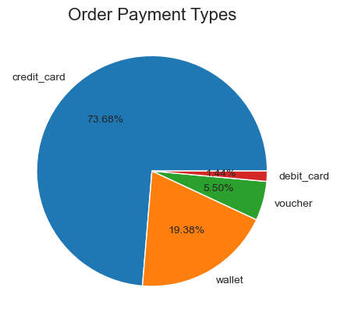
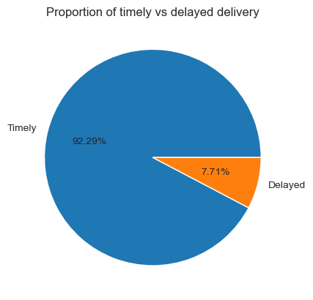
Payment status
Delivery status

Slide 5
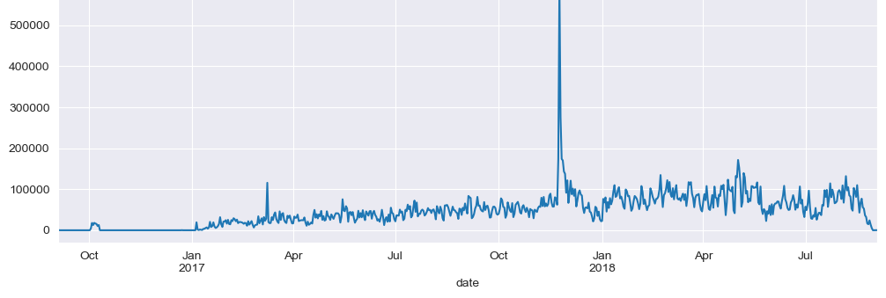
Revenue trend over time (daily)
The revenue record is generated for a period of 2 years from Sep’16- Sep’18
A spike is visible in Q1 & Q4 of 2017.
Explained in next slide

Slide 6
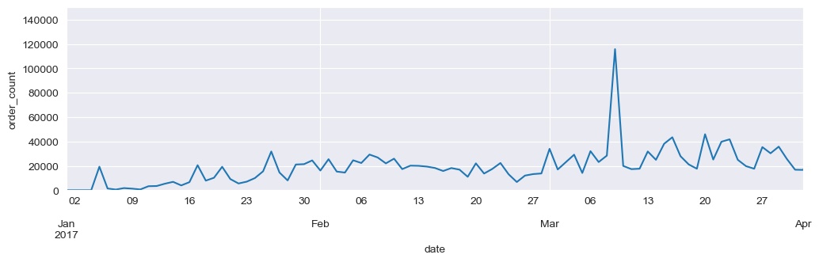
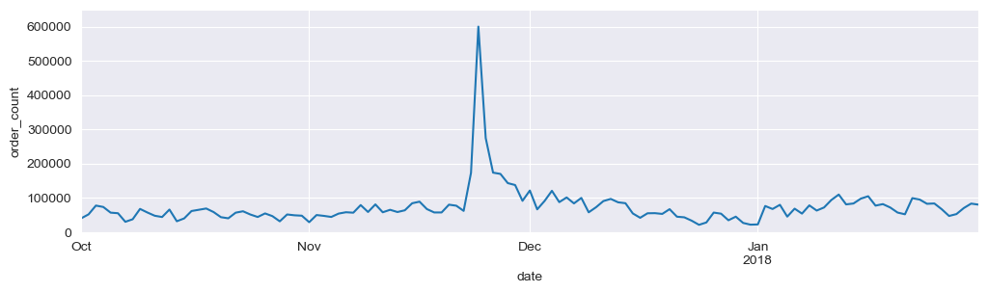
Explaining: Significant changes in sales
peak in Apr'17, due to Easter holidays
peak in Nov'17 from high volume sales due to Christmas holidays

Slide 7
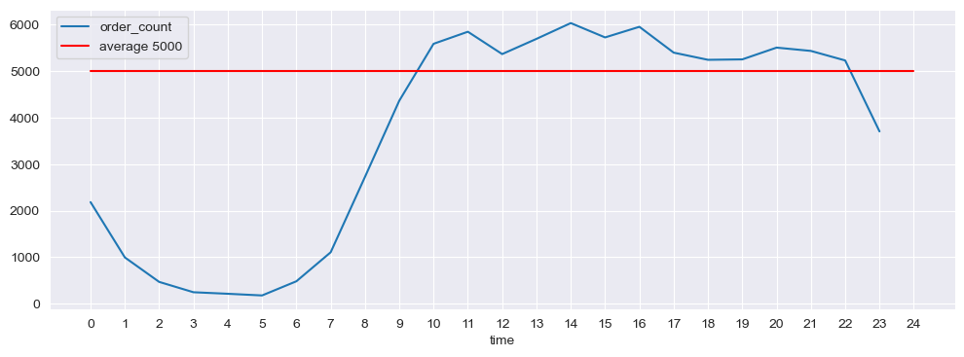
peak hours or days for order placements?
Orders boom between 1000 hrs, fall slightly after 1600 hrs, and then finally fall after 2200 hrs

Slide 8
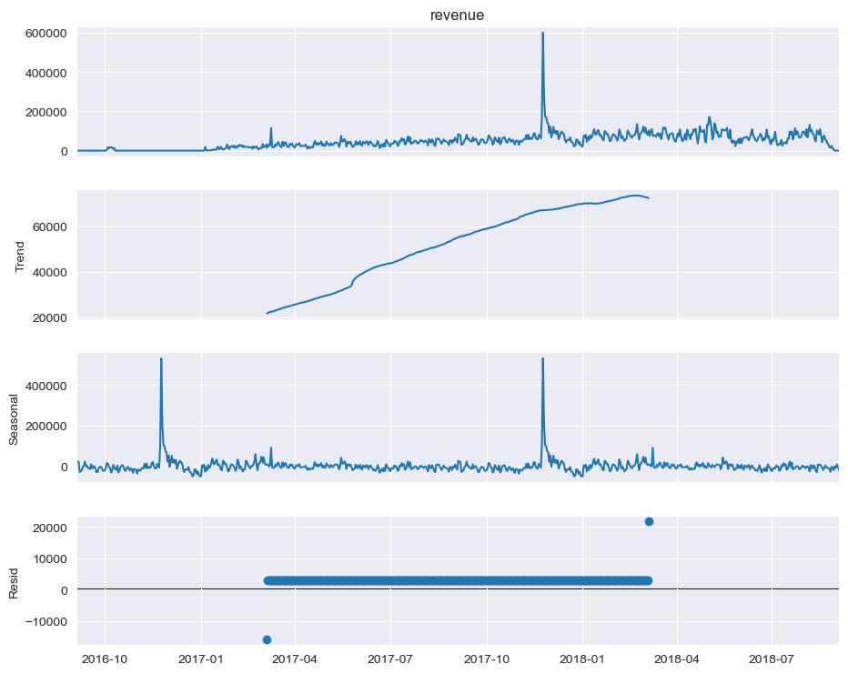
Seasonal Decomposition daily sales
Trend is Up
Yearly Seasonality

Slide 9
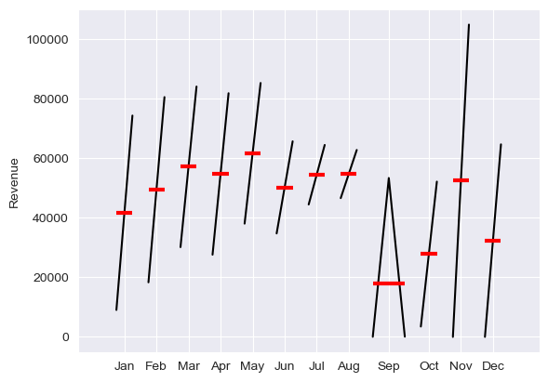
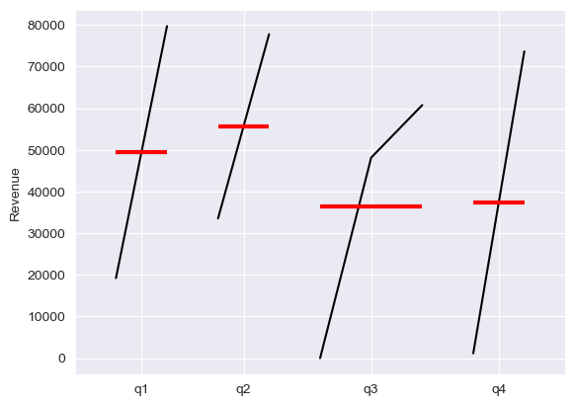
Time series: Month and quarter plots

Slide 10
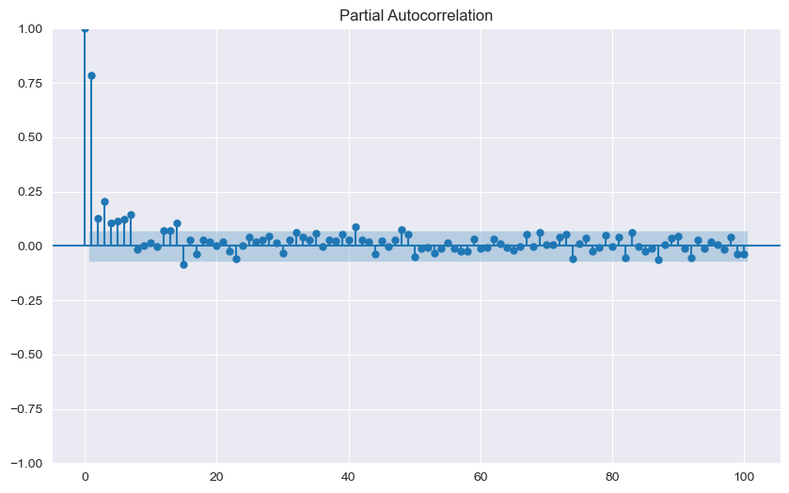
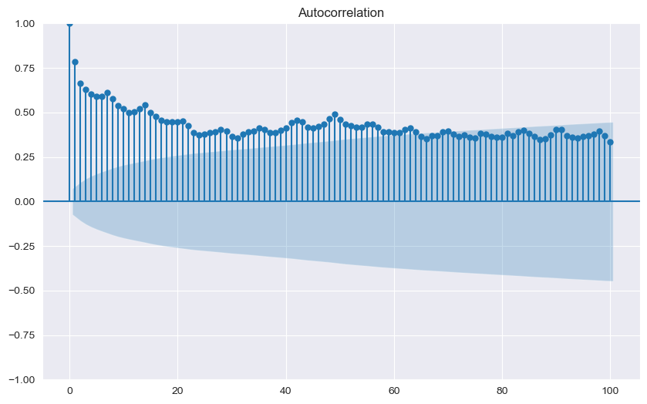
Time series: pacf & acf plots
PACF for daily revenue, and its lags.
Significant relation with lags 1,2,3,4,5,6,13,14,41
ACF with 100 lags, showing a strong correlation with daily revenue and its lags.

Slide 11
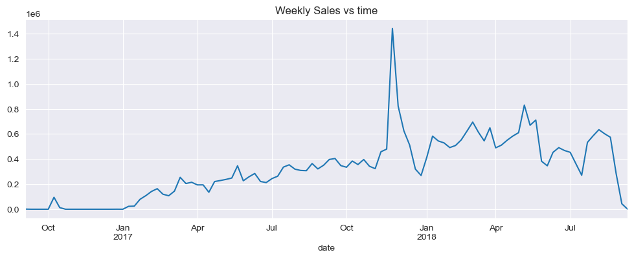
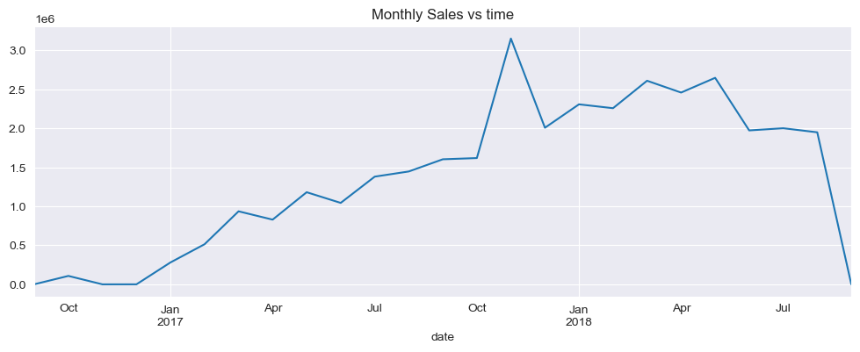
sales trend: weekly sales trend: monthly

Slide 12
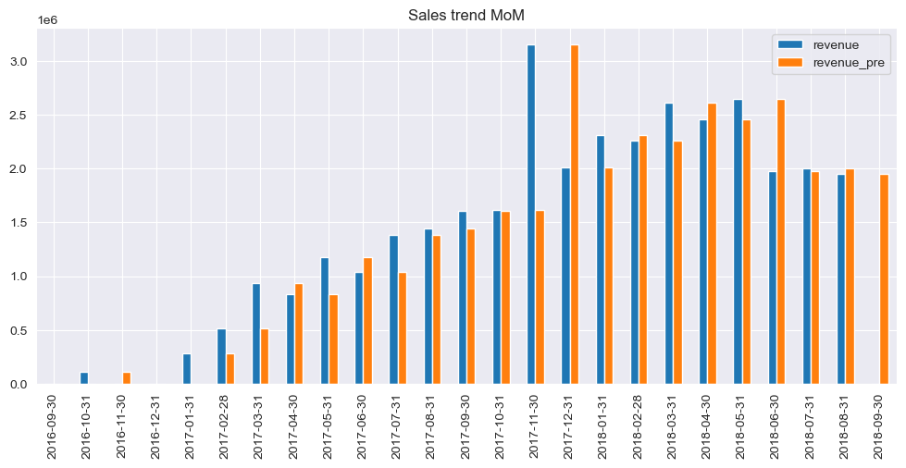
MoM: sales performance
Nov’17 has been the best month so far with Highest Sales recorded in the period.

Slide 13
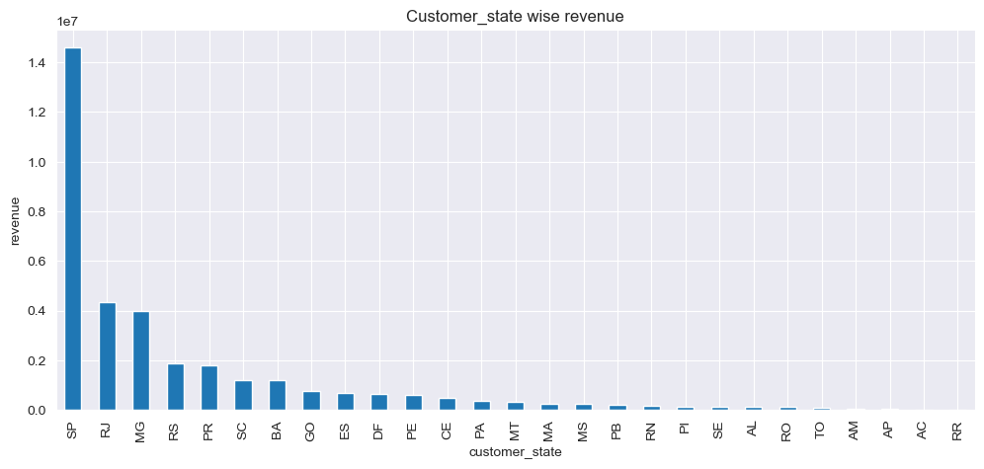
REVENUE WISE: CUSTOMER STATE

Slide 14
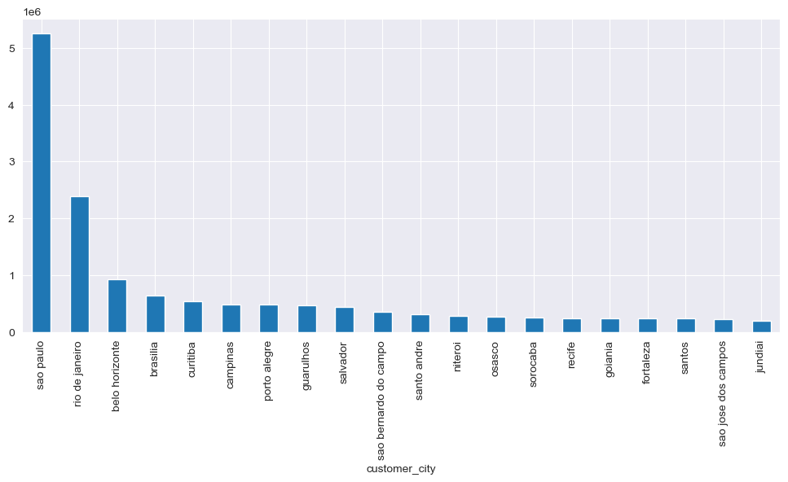
REVENUE WISE: CUSTOMER CITY

Slide 15
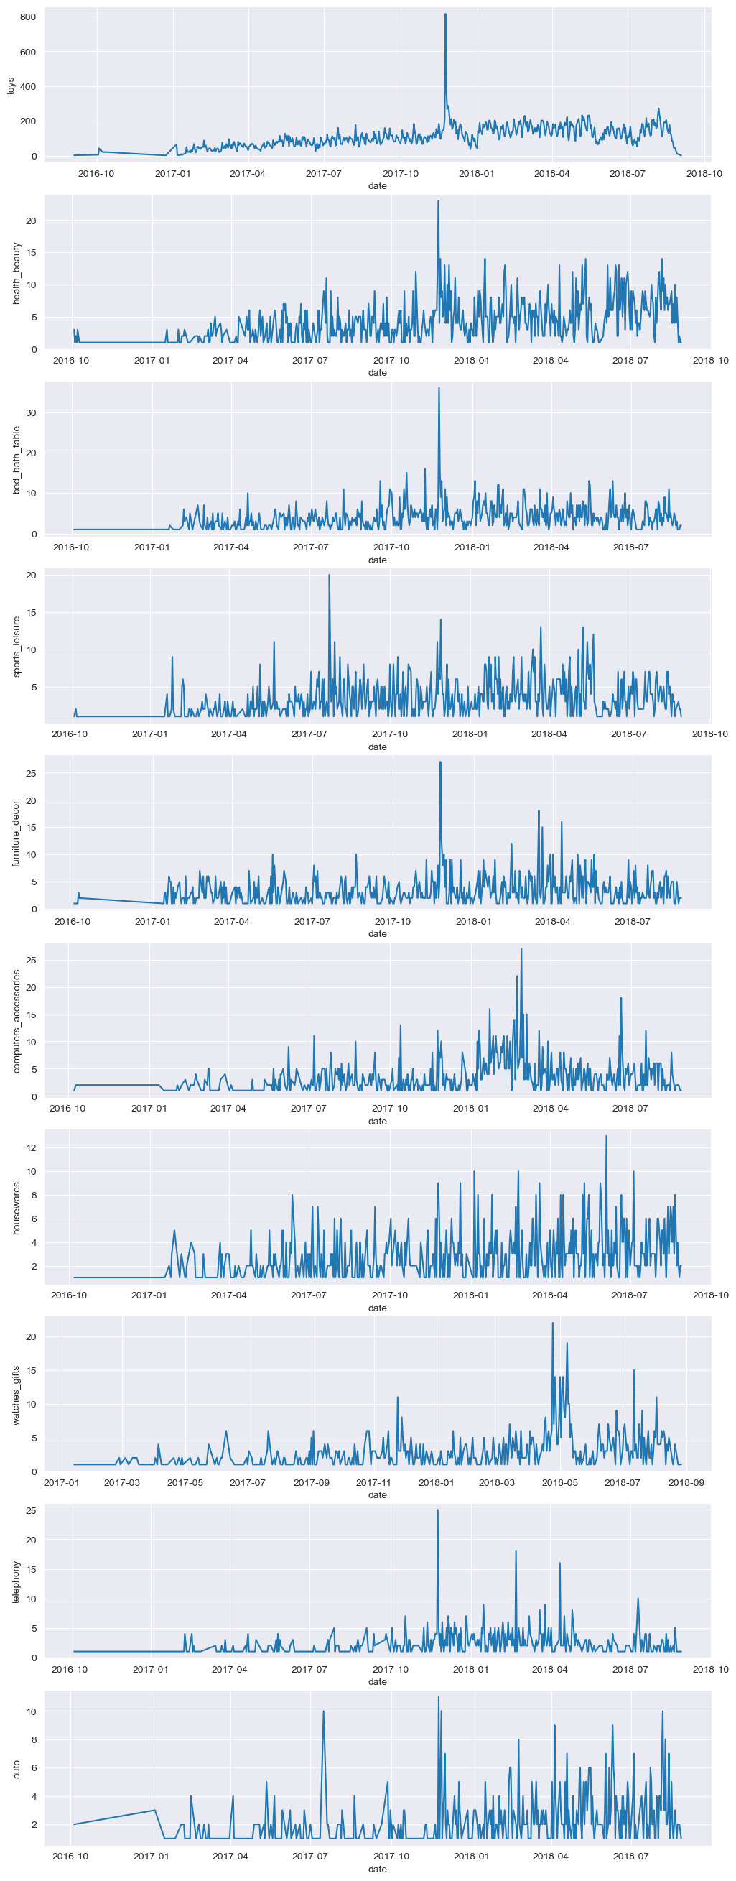
SALES TREND: TOP 10 PRODUCTS

Slide 16
Top 10 cities for top 3 selling products
Toys | Watches_Gifts | Construction_Tools_Garden
1. Sao Paulo | 1. Sao Paulo | 1. Barbacena
2. Rio de Janeiro | 2. Rio de Janeiro | 2. Sao Paulo
3. Belo Horizonte | 3. Santo Andre | 3. Campinas
4. Brasilia | 4. Brasilia | 4. Manaus
5. Curitiba | 5. Belo Horizonte | 5. Belo Horizonte
6. Campinas | 6. Guarulhos | 6. Aracatuba
7. Guarulhos | 7. Sao Bernardo do Campo | 7. Niteroi
8. Porto Alegre | 8. Joao Pessoa | 8. Caico
9. Salvador | 9. Osasco | 9. Rio de Janeiro
10. Sao Bernardo do Campo | 10. Fortaleza | 10. Nova Iguacu

Slide 17

thankyou

